Slide 1

Predictive Modeling and Machine Learning Insights from NYC Taxi Data
Prastut Dahal
Dipika Bogati
Ujjwal Kuikel

Slide 2
Introduction
Efficient transportation systems are the backbone of urban economies.
Understanding how transportation operates can improve the mobility and reduce inefficiencies
Predicting fares dynamics, transportation patterns and passenger’s behavior can help optimize resource allocation
Insights from this study can support sustainable urban planning and smart transit systems.

Slide 3
Questions we answered
Can we predict fair amount based on other features like trip distance, passenger count, etc?
Can we predict payment type based on other features?
Can we forecast future demand and revenue based on past data?

Slide 4
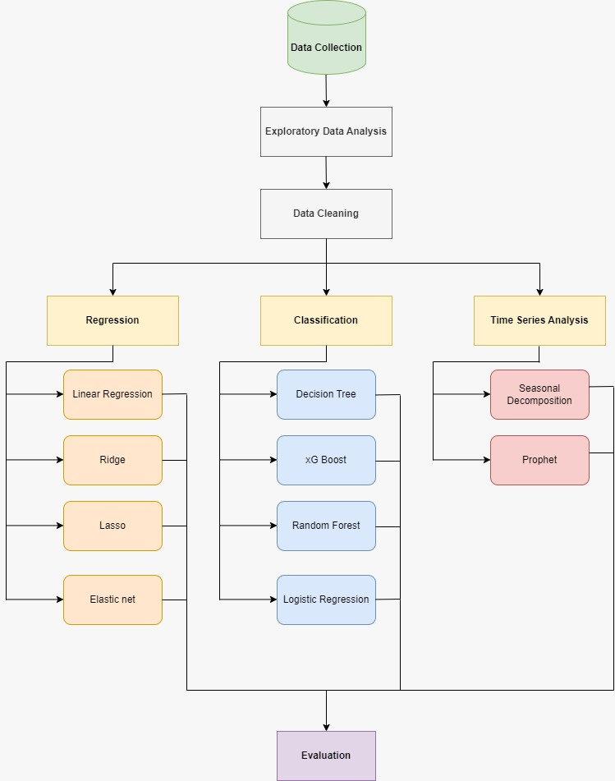
Flowchart

Slide 5
Dataset
Source:
NYC Taxi & Limousine Commission (TLC) Yellow Taxi Trip Records
Open dataset with millions of trip records from NYC taxis
Key Features:
Trip Details: Pickup and drop-off locations, timestamps, trip distance
Fare Information: Total fare, tip amount, payment type
Passenger Data: Number of passengers per trip
Time-Related Attributes: Pickup time, dropoff time

Slide 6
Data Cleaning
Handling Missing Data:
Checked for missing values and imputed or removed rows/columns as needed.
Feature Engineering:
Created new features (e.g., trip_duration, hour_of_day, day_of_week) based on raw data.
Encoded Categorical Variables:
Used one-hot encoding or label encoding for categorical data.
Handled Duplicates:
Checked for and removed duplicate rows to avoid skewing results.
Outlier Detection and Removal:
Identified and removed outliers in numerical features (e.g., extreme trip fares, durations).

Slide 7
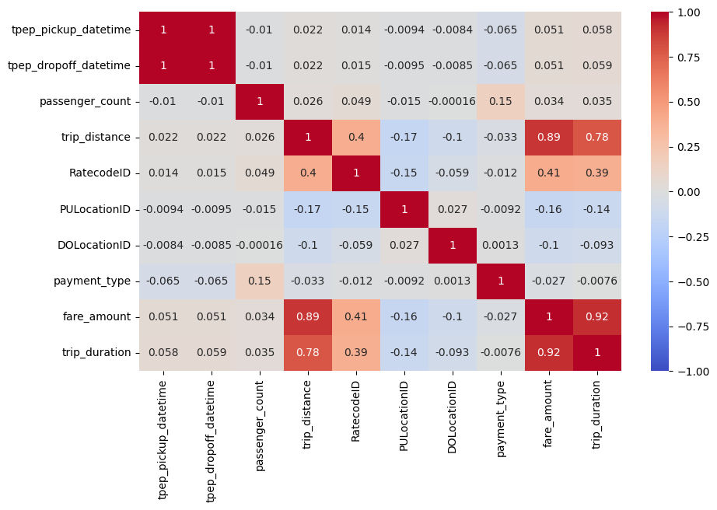
EDA

Slide 8
Modelling

Slide 9
Regression

Slide 10
Regression

